Slide 1

Health Roof
CAPSTONE PROJECT
FALL SEMESTER 2022-23
Final Review
All in One Solution

Slide 2
Guided By- Prof. D.Sumathi Mam
Done By-​
Y.Avinash Mani Kiran – 19BCE7466​
S.Lakshmi Prasanna – 19BCE7317​
M.Amulya - 19BCE7752

Slide 3
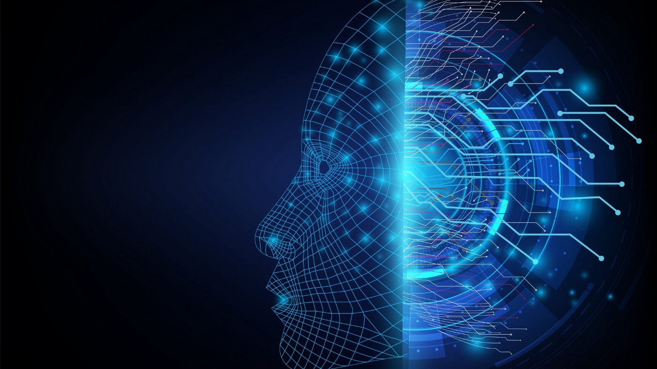
Motivation
Recently the time has been difficult for all of us and every second person around is suffering from one or the other disease, that’s why we tried to bring everything under one platform.
The main advantage of this project is that we can get the test results immediately at our home with a just few clicks.
The future is all about AI so here we present our idea of bringing 7 disease detections under one roof using the power of AI.

Slide 4
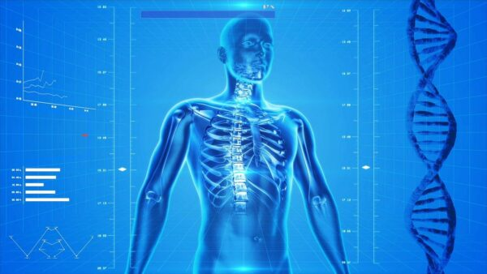
Objective
Integration of Artificial Intelligence with medical field
Making disease detection a click away
The idea of creating an online platform where we brought together all of these disease detections under the one roof.
It contains both simple and advanced type of detection

Slide 5
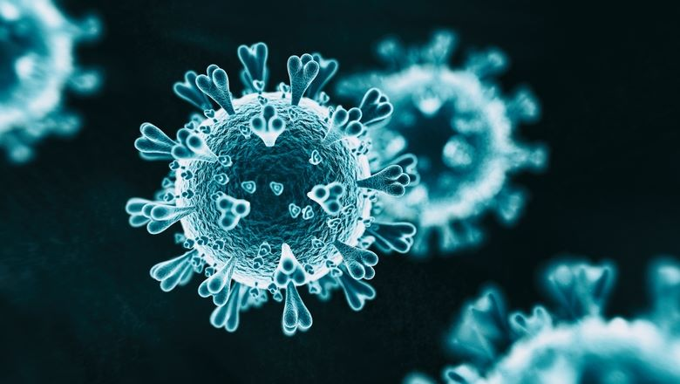
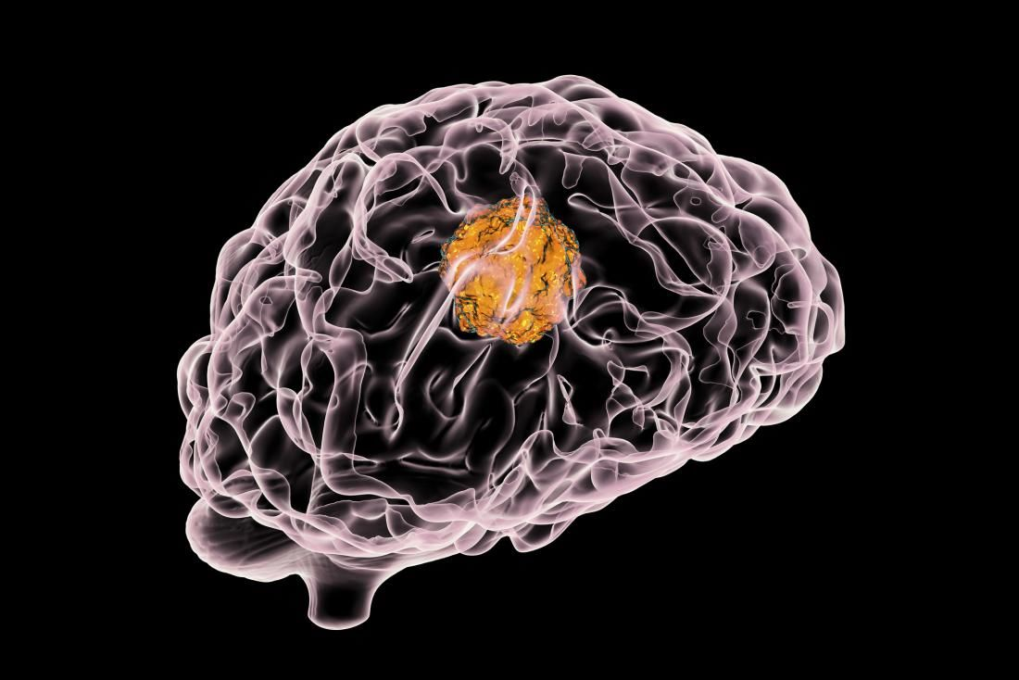

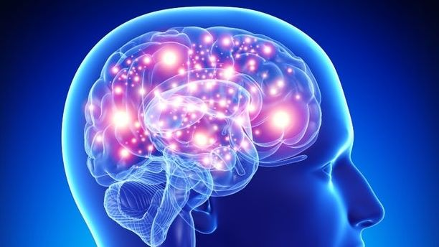
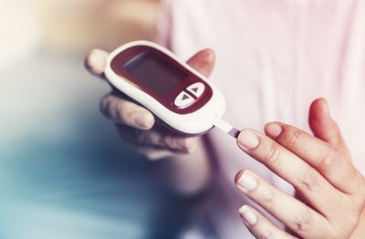
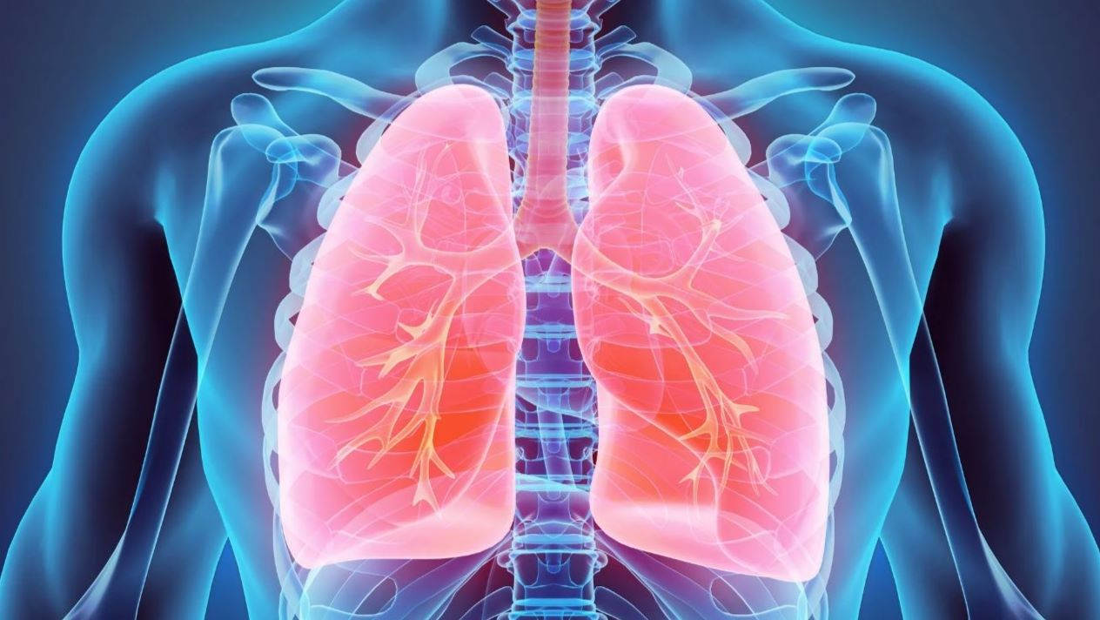

7 Disease Detections:
Covid-19 detection
Brain Tumour detection
Breast Cancer detection
Alzheimer detection
Diabetes detection
Pneumonia detection
Heart disease detection

Slide 6








Requirements
Software:
Python (version 3.6 or higher)
Anaconda (for various python libraries)
Tensorflow-gpu
Flask(backend)
Html(front end)
Visual Studio Code(IDE)
OpenCV
Hardware:
•Laptop
CSS

Slide 7
Timeplan
Review 1
Review 2
Implementation of algorithms and UI of input forms
Review 3
Gathering the information regarding project ,identifying the tools ,studying about the best algorithm to use
Complete implementation and displaying results
Final Review
Includes detailed description of project

Slide 8

Convolutional Neural Network
A Convolutional Neural Network (ConvNet/CNN) is a Deep Learning algorithm which can take an input image, assign importance to various aspects/objects in the image and be able to differentiate one from the other.

Slide 9
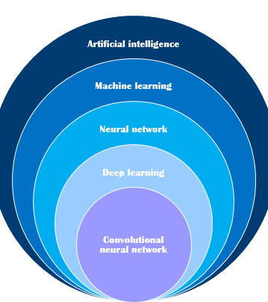
Why CNN?
Less pre-processing is required
Successfully captures Spatial and Temporal dependencies
Reduces images without losing features

Slide 10
Methods used
Customised CNN
VGG – 16
Random Forest
XGBoost

Slide 11
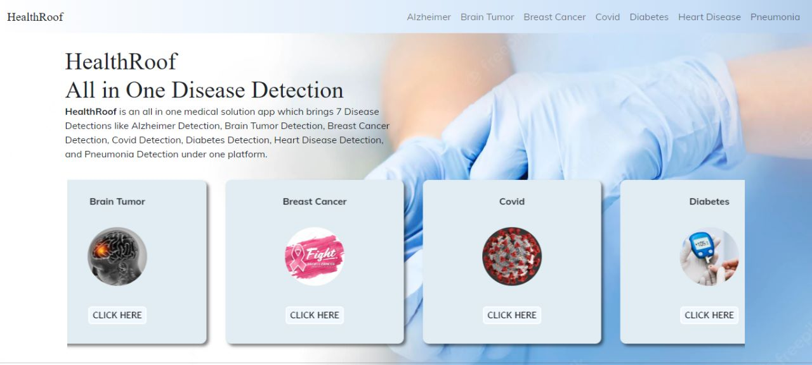

Slide 12
Covid-19 Detection
Most Common Symptoms: Fever,Dry cough,Tiredness
Covid 19 affects different people in different ways.
Less Common Symptoms: Aches and pains ,Sore throat ,Diarrhea,Conjunctivitis ,Headache,Loss of taste or smell
Most infected people will develop mild to moderate illness and recover without hospitalization.

Slide 13
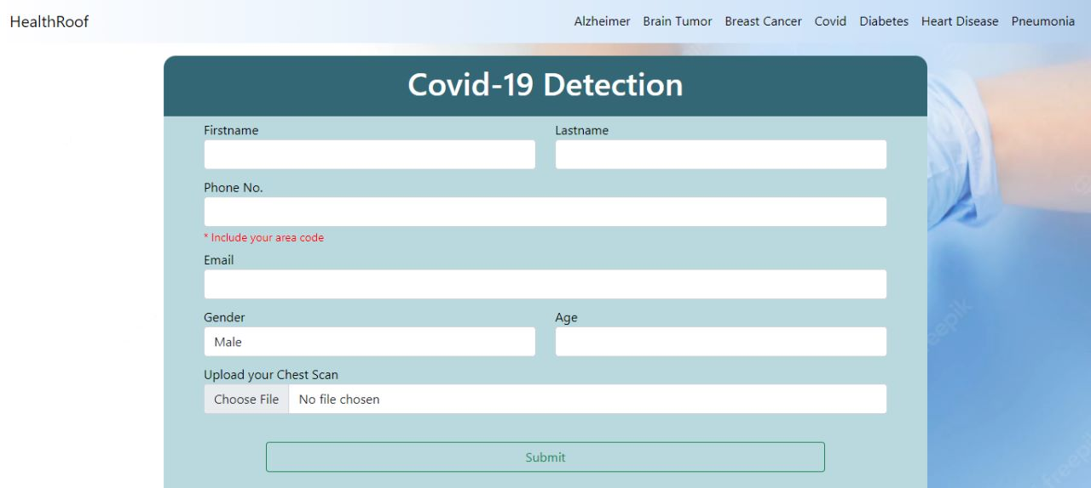

Slide 14
Brain Tumour Detection
Brain tumors can be cancerous (malignant) or noncancerous (benign).
Tumors can start in the brain, or cancer elsewhere in the body can spread to the brain.
When benign or malignant tumors grow, they can cause the pressure inside your skull to increase. This can cause brain damage, and it can be life-threØ
Symptoms are:new or increasingly strong Headaches ,blurred vision,loss of balance,confusion and seizures ,in some cases, there may be no symptoms

Slide 15
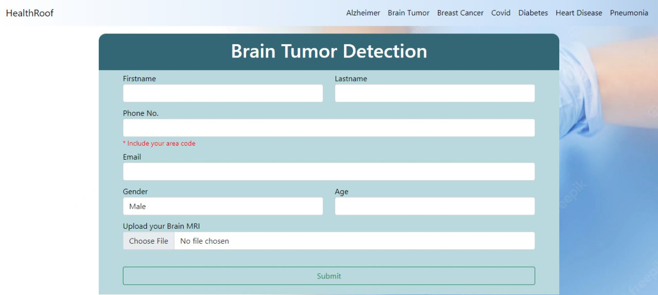

Slide 16
Breast Cancer Detection
Cancer that forms in the cells of the breast .
Breast Cancer can occur in women and rarely in men.
Breast cancer survival rates have increased, and the number of deaths associated with this disease is steadily declining, largely due to factors such as earlier detection, a new personalized approach to treatment and a better understanding of the disease.
Symptoms of Breast Cancer: a lump in the breast,bloody discharge from the nipple,changes in the shape or texture of nipple or breast.,redness or pitting of the skin over your breast, like the skin of an orange

Slide 17
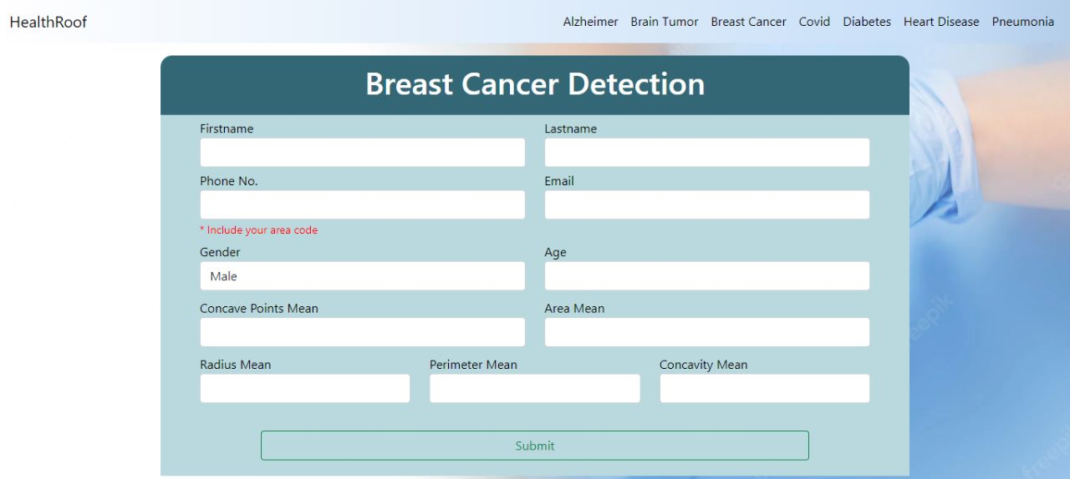

Slide 18
Alzheimer Detection
Progressive disease that destroys memory and other important mental functions.
Brain Cell connections and the cell themselves degenerate and die, eventually destroying memory and other important mental functions.
Memory loss is the key symptom of Alzheimer disease.
Early signs include difficulty in remembering recent events or conversations.
As the disease progress memory impairments worsen and other symptoms develop.
There is no treatment that cures Alzheimer's disease or alters the disease process in the brain.

Slide 19


Slide 20
Diabetes Detection
Diabetes is a disease that occurs when your blood glucose, also called blood sugar, is too high. Also known as blood sugar.
Symptoms include: increased thirst ,frequent urination,hunger,fatigue,blurred vision.In some cases , there may be no symptoms.
Although diabetes has no cure, you can take steps to manage your diabetes and stay healthy.

Slide 21
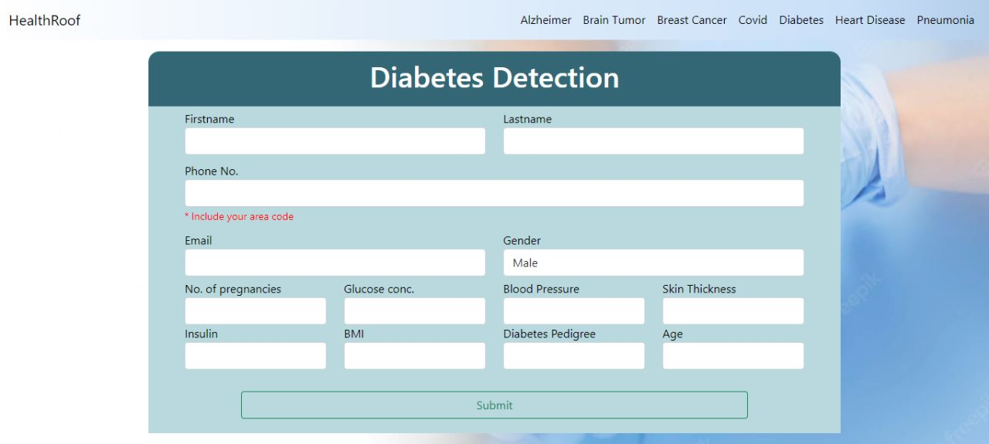

Slide 22
Pneumonia Detection
Infection that inflames air sacs in one or both lungs which may fill with fluids.
With pneumonia the air sacs may fill with fluid or pus.
It is most serious for infants and young children, people older than age 65, and people with health problems or weakened immune systems.
Symptoms of pneumonia:Coughing that may produce phlegm,Fever,Shortness of breath,Sweating or chills,Nausea or vomiting,Loss of appetite

Slide 23
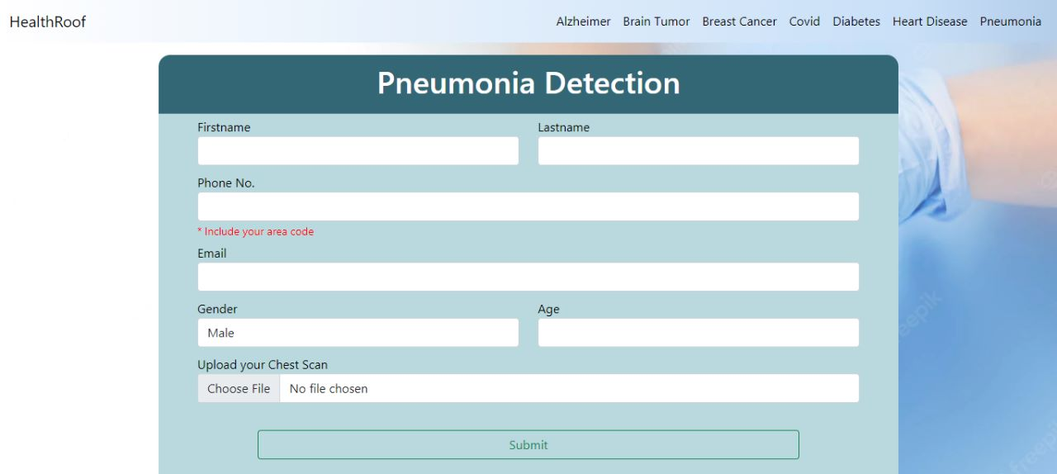

Slide 24
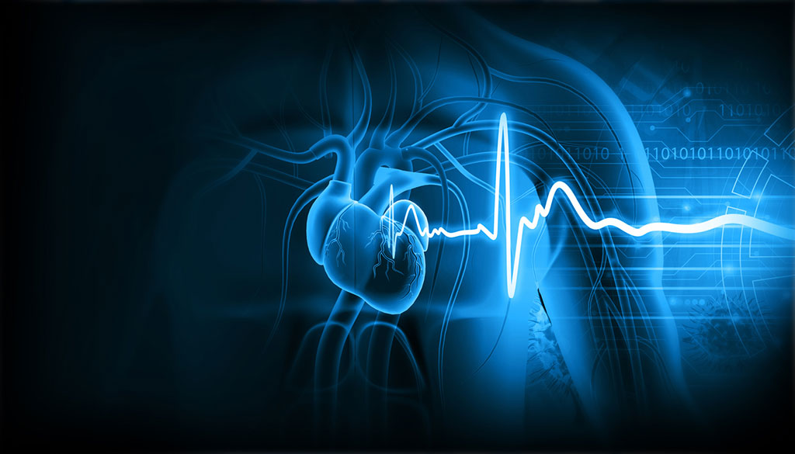
Heart Disease Detection
Heart disease refers to any conditions affecting the heart.
Heart disease describes a range of conditions that affect your heart. Heart diseases include:Blood vessel disease, such as coronary artery disease,Heart rhythm problems (arrhythmias),Heart defects you're born with (congenital heart defects),Heart valve disease,Disease of the heart muscle,Heart infection
Signs and symptoms can include:Chest pain, chest tightness, chest pressure and chest discomfort (angina),Shortness of breath,Pain, numbness, weakness or coldness in your legs or arms if the blood vessels in those parts of your body are narrowed,Pain in the neck, jaw, throat, upper abdomen or back
Unlike cardio vascular diseases , which includes problem with the entire circulatory system, heart diseases affects only heart.

Slide 25
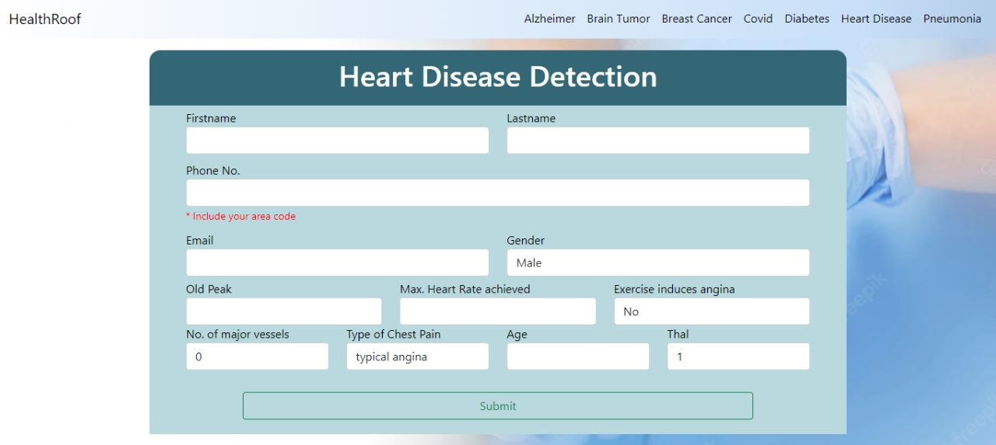

Slide 26

RESULTS

Slide 27
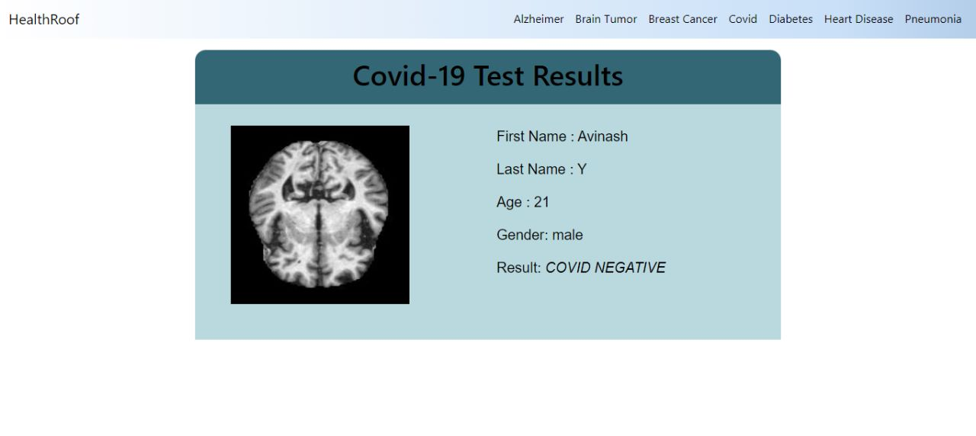

Slide 28
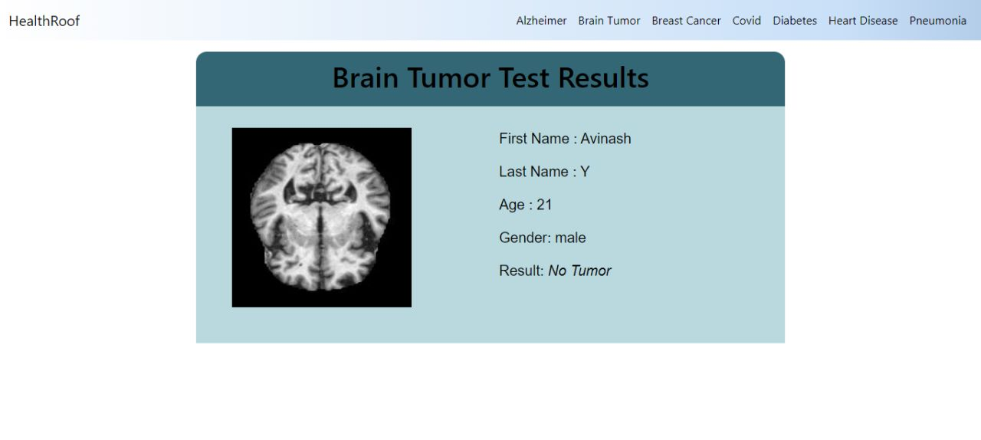

Slide 29
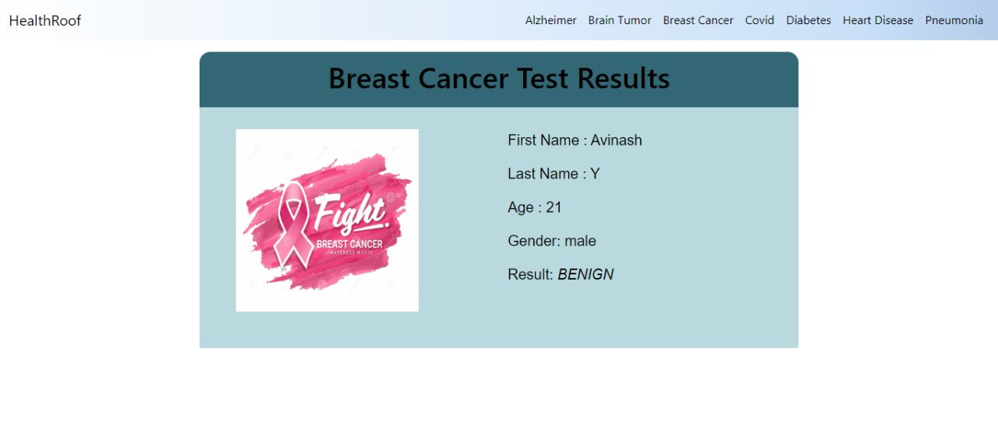

Slide 30
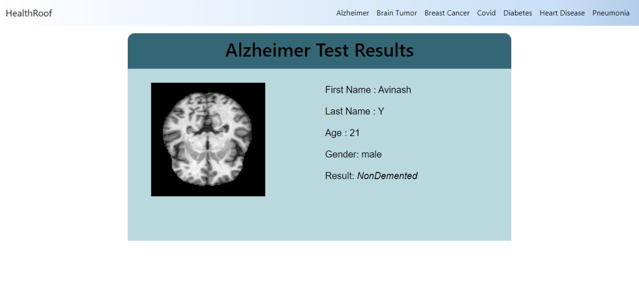

Slide 31
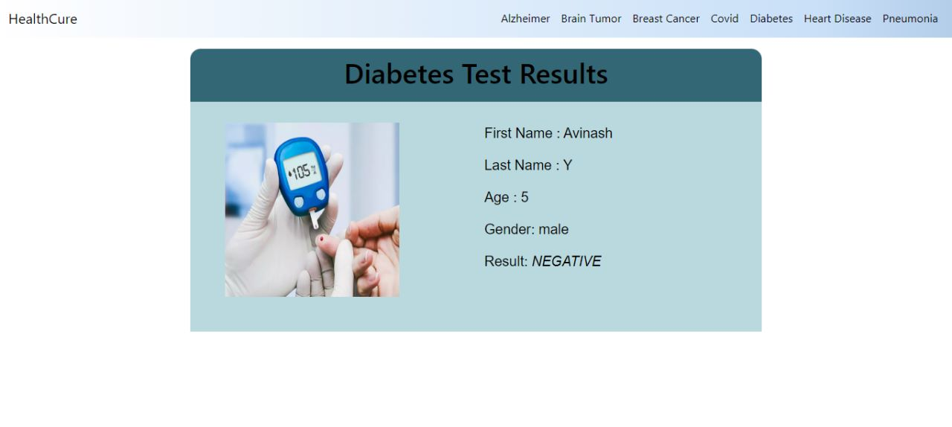

Slide 32
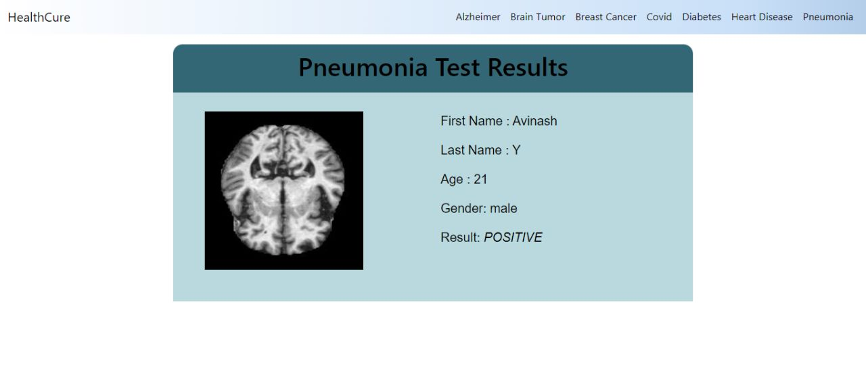

Slide 33
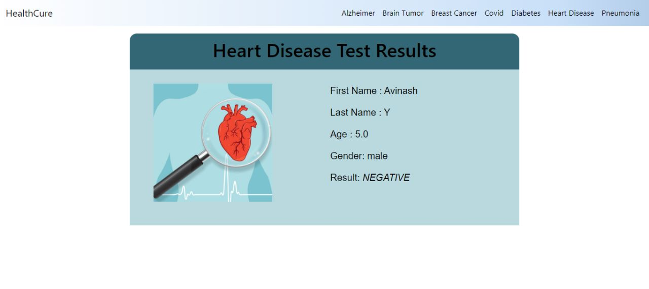

Slide 34

Applications
Disease detection is one field where intervention of human experts is required ,through HealthRoof this process is simplified.
Adding more disease detections which can be detected using X-ray scans or just by inputting simple numbers will be more effective
We can add more various features like if a person is found positive then precautions can be displayed
Even can be modified by providing a feature to book online appointments based on severity level.

Slide 35
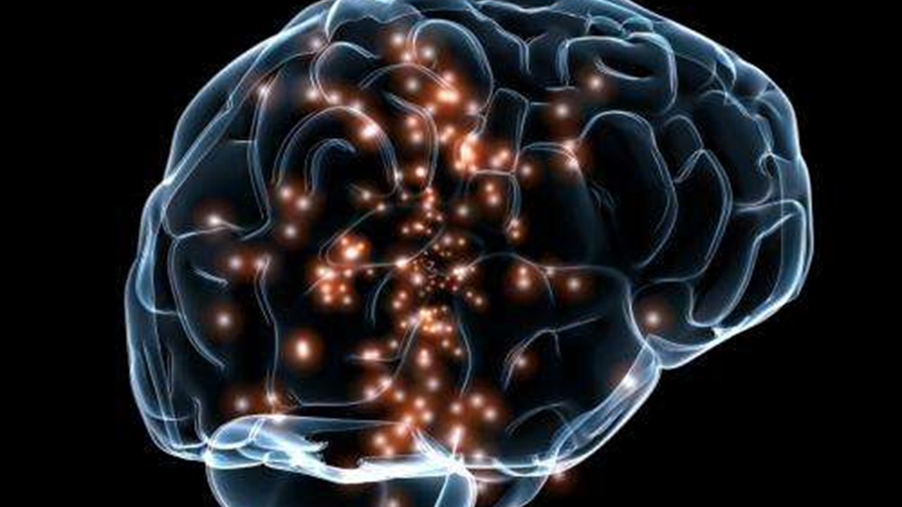
CONCLUSION
Artificial intelligence (AI) is gradually changing medical practice. With recent progress in digitized data acquisition, machine learning and computing infrastructure, AI applications are expanding into areas that were previously thought to be only the province of human experts.Recent breakthroughs in AI technologies and their biomedical applications, identify the challenges for further progress in medical AI systems, and summarize the economic, legal and social implications of AI in healthcare.
Through this we bring all disease detection under one roof and makes disease detection one click away.
HEALTH ROOF ….
ALL IN ONE SOLUTION

Slide 36

THANK YOU

